Slide 1


CS371: Artificial Intelligence
July – November 2020
Chapter – 1
Introduction to AI
Devang Patel Institute of Advance Technology and Research

Slide 2
What is AI?
Various definitions:
  Building intelligent entities.
  Getting computers to do tasks which require human intelligence.
But what is “intelligence”?
Simple things turn out to be the hardest to automate:
  Recognising a face.
  Navigating a busy street.
  Understanding what someone says.
All tasks require reasoning on knowledge.

Slide 3
Why do AI?
Two main goals of AI:
  To understand human intelligence better. We test theories of human intelligence by writing programs which emulate it.
  To create useful “smart” programs able to do tasks that would normally require a human expert.

Slide 4
Who does AI?
Many disciplines contribute to goal of creating/modelling intelligent entities:
  Computer Science
  Psychology (human reasoning)
  Philosophy (nature of belief, rationality, etc)
  Linguistics (structure and meaning of language)
  Human Biology (how brain works)
Subject draws on ideas from each discipline.

Slide 5
Typical AI Problems
Intelligent entities (or “agents”) need to be able to do both “mundane” and “expert” tasks:
Mundane tasks - consider going shopping:
  Planning a route, and sequence of shops to visit!
  Recognising (through vision) buses, people.
  Communicating (through natural language).
  Navigating round obstacles on the street, and manipulating objects for purchase.
Expert tasks are things like:
  medical diagnosis.
  equipment repair.
Often “mundane” tasks are the hardest.

Slide 6
Philosophical Issues
What is intelligence?
Can a machine be truly “intelligent”? Is there more to human intelligence than rules, data and calculations?
Tests:
Turing Test: Can someone tell which is the machine, when communicating to human and to a machine in another room? If not, can we call the machine intelligent?
Chinese room: Searle says no. Describes a thought experiment where talk in Chinese by looking up what to say from huge rule book.
Loebner contest: Contest for most human-like conversation system.

Slide 7
Example conversation with system winning Loebner prize
P: No worries! Hey! I didn’t come here to be subjected to bad language! How rude!
J: Sorry, sorry. Didn’t mean to offend. So, how old are you?
P: That’s OK. Just don’t do it again. Well, should my age really matter. Just for the record I’m 24. How old are you then.
But.. System was based on fairly simple methods, with pre-stored amusing replies. These simple methods first used in “Eliza” - a program to emulate psychotherapist.
  Try esc-x doctor while in emacs for a version of Eliza.
Human-like performance doesn’t guarantee intelligence.

Slide 8
About this Module
Covers following AI topics
  AI Programming, using Prolog.
  Knowledge representation:
    How do we represent knowledge about the world in a formal manner that can be manipulated in a sound and efficient manner?
  Search:
    How can an AI system go through all the possibilities in a systematic manner when looking for solutions to complex problems.

Slide 9
About this Module
  Natural Language:
    How can a system communicate in a natural language such as English.
  Vision:
    How can it recognise objects from a bit-map image from a camera.
  Machine learning and neural networks:
    How can a system learn from experience, or from past case data.
  Current applications:
    Some current applications to Web services, and in data mining.

Slide 10
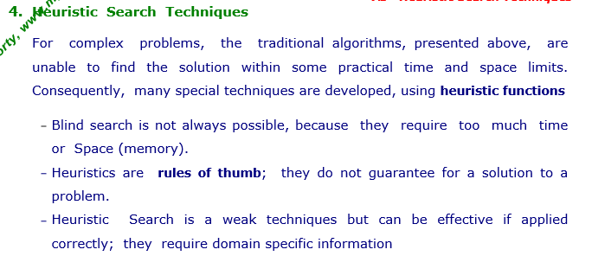

Slide 11
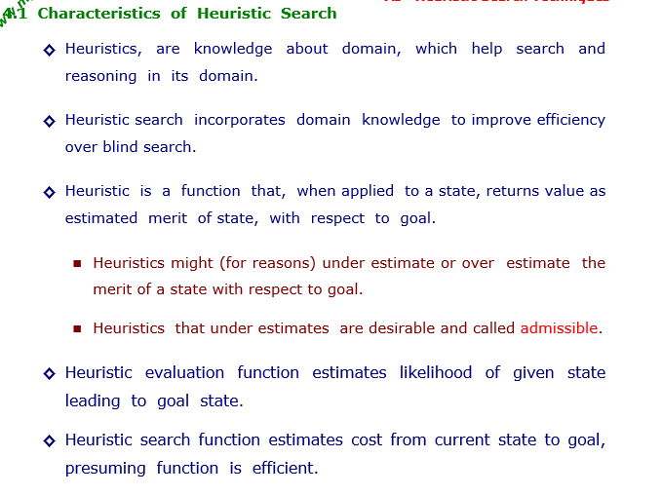

Slide 12
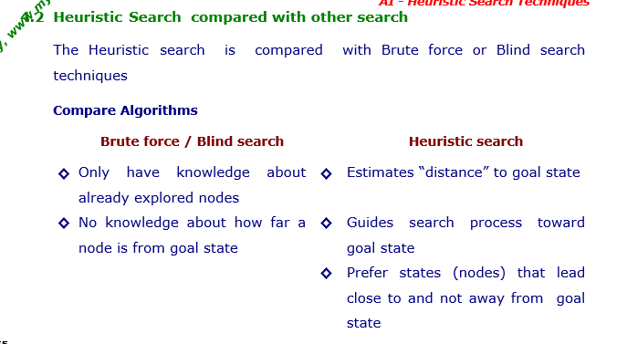

Slide 13
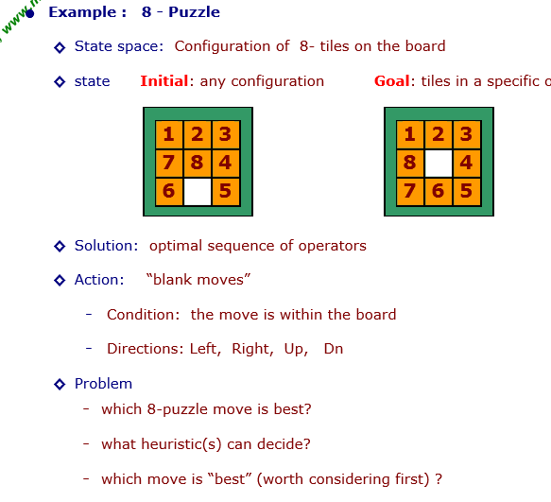

Slide 14
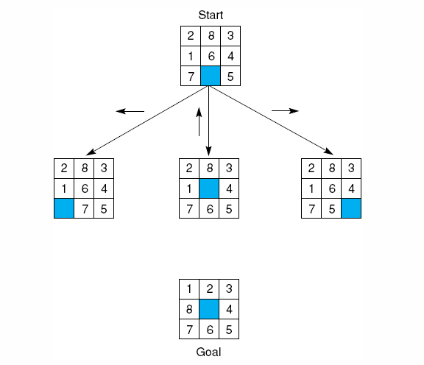
An example-8 puzzle.
Notes:
Insert fig 4.12

Slide 15
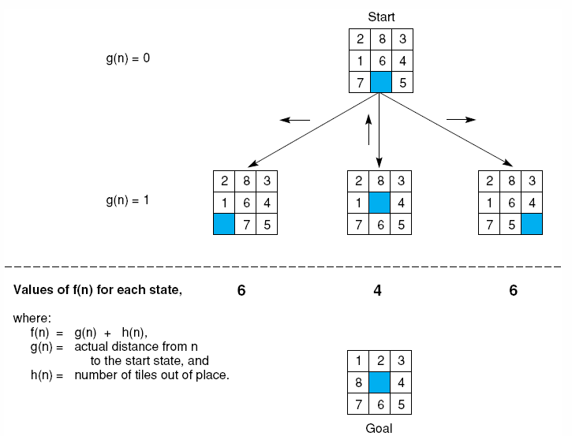
Notes:
Insert fig 4.15

Slide 16
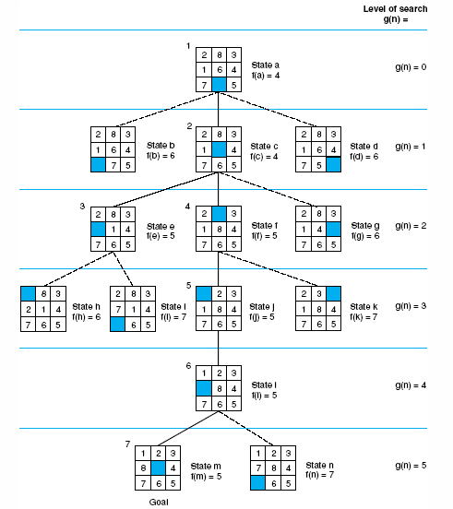
Notes:
Insert fig 4.16

Slide 17
Generate-and-Test
Algorithm
Generate a possible solution.
Test to see if this is actually a solution.
Quit if a solution has been found.
Otherwise, return to step 1.

Slide 18
Generate-and-Test
Acceptable for simple problems.
Inefficient for problems with large space.

Slide 19
Generate-and-Test
Exhaustive generate-and-test.
Heuristic generate-and-test: not consider paths that seem unlikely to lead to a solution.
Plan generate-test:
− Create a list of candidates.
− Apply generate-and-test to that list.

Slide 20
Generate-and-Test
Example: coloured blocks
“Arrange four 6-sided cubes in a row, with each side of
each cube painted one of four colours, such that on all four
sides of the row one block face of each colour is showing.”

Slide 21
Generate-and-Test
Example: coloured blocks
Heuristic: if there are more red faces than other colours
then, when placing a block with several red faces, use few
of them as possible as outside faces.

Slide 22
Hill Climbing
Generate-and-test + direction to move.
Heuristic function to estimate how close a given state is to a goal state.

Slide 23
Simple Hill Climbing
Algorithm
Evaluate the initial state.
Loop until a solution is found or there are no new operators left to be applied:
− Select and apply a new operator
− Evaluate the new state:
goal → quit
better than current state → new current state

Slide 24
Steepest-Ascent Hill Climbing (Gradient Search)
Considers all the moves from the current state.
Selects the best one as the next state.

Slide 25
Steepest-Ascent Hill Climbing (Gradient Search)
Algorithm
Evaluate the initial state.
Loop until a solution is found or a complete iteration produces no change to current state:
− SUCC = a state such that any possible successor of the
current state will be better than SUCC.
− For each operator that applies to the current state, evaluate
the new state:
goal → quit
better than SUCC → set SUCC to this state
− SUCC is better than the current state → set the current
state to SUCC.

Slide 26
Hill Climbing: Disadvantages
Local maximum
A state that is better than all of its neighbours, but not
better than some other states far away.

Slide 27
Hill Climbing: Disadvantages
Plateau
A flat area of the search space in which all neighbouring
states have the same value.

Slide 28
Hill Climbing: Disadvantages
Ridge
The orientation of the high region, compared to the set
of available moves, makes it impossible to climb up.
However, two moves executed serially may increase
the height.

Slide 29
Hill Climbing: Disadvantages
Ways Out
Backtrack to some earlier node and try going in a different direction.
Make a big jump to try to get in a new section.
Moving in several directions at once.

Slide 30
Hill Climbing: Disadvantages
Hill climbing is a local method:
Decides what to do next by looking only at the “immediate” consequences of its choices.
Global information might be encoded in heuristic functions.

Slide 31
Hill Climbing: Disadvantages
Start
A
Goal
D
0
4
D
C
C
B
B
A
Blocks World
Local heuristic:
+1 for each block that is resting on the thing it is supposed to be resting on.
−1 for each block that is resting on a wrong thing.

Slide 32
Hill Climbing: Disadvantages
0
A
2
D
D
C
C
B
B
A

Slide 33
Hill Climbing: Disadvantages
D
2
C
B
A
A
0
0
D
C
C
D
C
0
B
B
A
B
A
D

Slide 34
Hill Climbing: Disadvantages
Start
A
Goal
D
−6
6
D
C
C
B
B
A
Blocks World
Global heuristic:
For each block that has the correct support structure: +1 to every block in the support structure.
For each block that has a wrong support structure: −1 to
every block in the support structure.

Slide 35
Hill Climbing: Disadvantages
D
−3
C
B
A
A
−6
−2
D
C
C
D
C
−1
B
B
A
B
A
D

Slide 36
Hill Climbing: Conclusion
Can be very inefficient in a large, rough problem space. Global heuristic may have to pay for computational complexity.
Often useful when combined with other methods, getting it started right in the right general neighbourhood.

Slide 37
Simulated Annealing
A variation of hill climbing in which, at the beginning of the process, some downhill moves may be made.
To do enough exploration of the whole space early on, so that the final solution is relatively insensitive to the starting state.
Lowering the chances of getting caught at a local maximum, or plateau, or a ridge.

Slide 38
Simulated Annealing
Physical Annealing
Physical substances are melted and then gradually cooled until some solid state is reached.
The goal is to produce a minimal-energy state.
Annealing schedule: if the temperature is lowered sufficiently slowly, then the goal will be attained.
Nevertheless, there is some probability for a transition to a higher energy state: e^{−ΔE/kT}.

Slide 39
Simulated Annealing
Algorithm
Evaluate the initial state.
Loop until a solution is found or there are no new operators left to be applied:
− Set T according to an annealing schedule
− Selects and applies a new operator
− Evaluate the new state:
goal → quit
ΔE = Val(current state) − Val(new state)
ΔE < 0 → new current state
else → new current state with probability e^{−ΔE/kT}.

Slide 40
Best-First Search
In BFS and DFS, when we are at a node, we can consider any of the adjacent as next node. So both BFS and DFS blindly explore paths without considering any cost function. The idea of Best First Search is to use an evaluation function to decide which adjacent is most promising and then explore. Best First Search falls under the category of Heuristic Search or Informed Search.
Depth-first search: not all competing branches having to be expanded.
Breadth-first search: not getting trapped on dead-end paths.
⇒ Combining the two is to follow a single path at a time, but switch paths whenever some competing path look more promising than the current one.

Slide 41
Best-First Search
OPEN: nodes that have been generated, but have not examined.
This is actually a priority queue.
CLOSED: nodes that have already been examined.
Whenever a new node is generated, check whether it has been generated before.

Slide 42
Best-First Search
OL: D B C
B E C F
E C H F G
J I C H F G
CL: A
A D
A D B E J
A
A
A
B
C
D
B
C
D
3
5
1
3
5
E
F
4
6
A
A
B
C
D
B
C
D
5
5
G
H
E
F
G
H
E
F
6
5
4
6
6
5
6
I
J
2
1

Slide 43
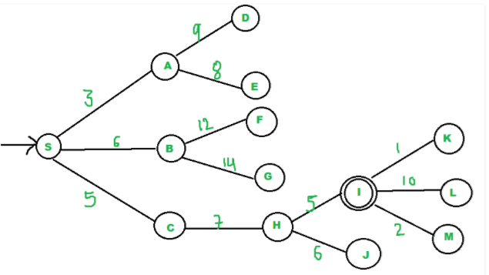
{A, C, B}
{C, B, E, D}
{B, H, E, D}
{H, E, D, F, G}
"I" is a neighbor of H, we return.

Slide 44
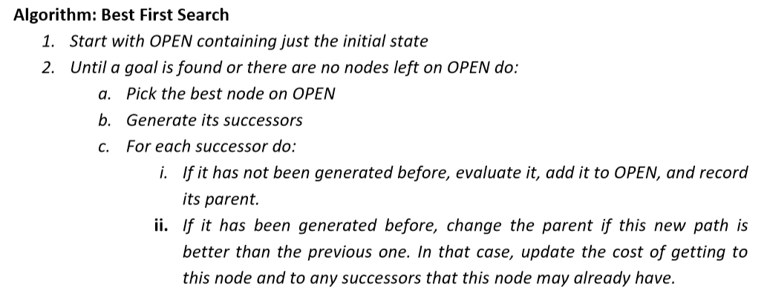
Best-First Search
Algorithm
OPEN = {initial state}.
Loop until a goal is found or there are no nodes left in OPEN:
− Pick the best node in OPEN
− Generate its successors
− For each successor:
new → evaluate it, add it to OPEN, record its parent
generated before → change parent, update successors

Slide 45
Best-First Search
Greedy search:
h(n) = estimated cost of the cheapest path from node n to a goal state.
Neither optimal nor complete
Uniform-cost search:
g(n) = cost of the cheapest path from the initial state to node n.
Optimal and complete, but very inefficient.

Slide 46
Analysis
The worst case time complexity for Best First Search is O(n * Log n) where n is number of nodes. In worst case, we may have to visit all nodes before we reach goal. Note that priority queue is implemented using Min(or Max) Heap, and insert and remove operations take O(log n) time.
Performance of the algorithm depends on how well the cost or evaluation function is designed.

Slide 47
Best-First Search
Algorithm A* (Hart et al., 1968):
f(n) = g(n) + h(n)
g(n) = cost of the cheapest path from the initial state to node n.
h(n) = cost of the cheapest path from node n to a goal state.

Slide 48
Best-First Search: A*
Algorithm A*:
f*(n) = g*(n) + h*(n)
h*(n) (heuristic factor) = estimate of h(n).
g*(n) (depth factor) = approximation of g(n) found by A* so far.

Slide 49
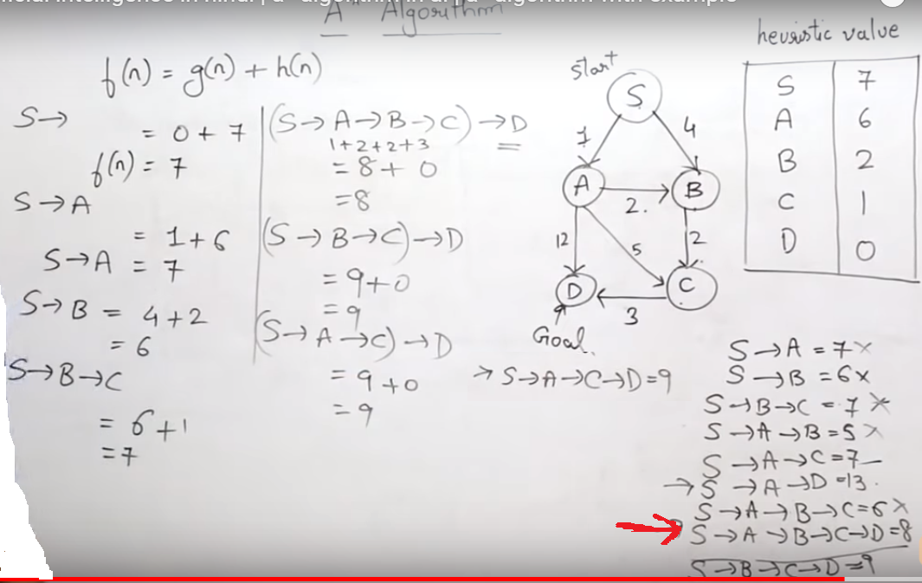

Slide 50
Best-First Search: A*
Create a search graph G, consisting solely the start node n₀.
Put n₀ on the list OPEN.
2. Set the list CLOSED = ∅.
3. If OPEN = ∅, then exit with failure.
4. Select the first node n in OPEN, remove it from OPEN, and put it on CLOSED.
5. If n is a goal node, then exit successfully with the solution obtained by tracing a path along the pointers from n to n₀.
6. Expand node n, generating the set M of its successors that are not already ancestors of n in G.

Slide 51
Best-First Search: A*
7. For each node m in M:
Not already on either OPEN or CLOSED → Add m to OPEN. Establish a pointer from m to n.
Already on either OPEN or CLOSED → Redirect its pointer to n if the best path to m found so far is through n.
8. Reorder the list OPEN in order of increasing f* values.
9. Go to step 3.

Slide 52
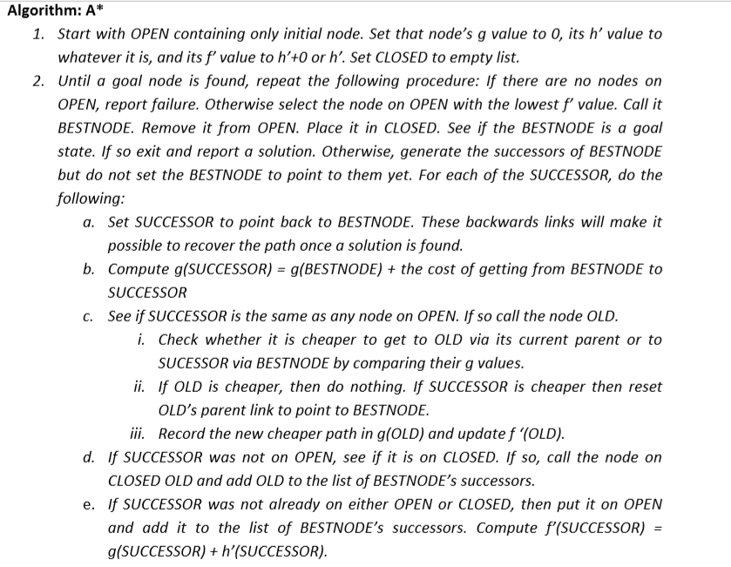

Slide 53
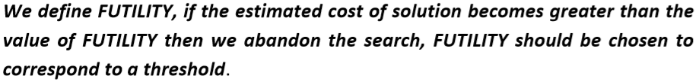
Problem Reduction
Goal: Acquire TV set
Goal: Steal TV set
Goal: Earn some money
Goal: Buy TV set
AND-OR Graphs
Algorithm AO* (Martelli & Montanari 1973, Nilsson 1980)

Slide 54
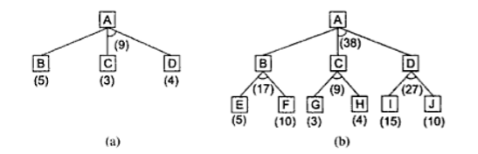

Slide 55
Problem Reduction: AO*
A
A
6
5
9
B
C
D
3
4
5
A
9
A
11
9
12
B
C
D
10
B
6
C
D
10
3
4
4
E
F
G
H
E
F
4
4
5
7
4
4

Slide 56
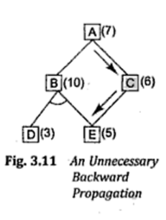
Problem Reduction: AO*
A
11
A
14
B
13
C
10
B
13
C
15
D
5
E
6
F
3
D
5
E
6
F
3
G
5
G
10
Necessary backward propagation
H
9

Slide 57
Constraint Satisfaction
Many AI problems can be viewed as problems of constraint satisfaction.
Cryptarithmetic puzzle:
SEND
MORE
MONEY
+

Slide 58
Constraint Satisfaction
As compared with a straightforard search procedure, viewing a problem as one of constraint satisfaction can reduce substantially the amount of search.

Slide 59
Constraint Satisfaction
Operates in a space of constraint sets.
Initial state contains the original constraints given in the problem.
A goal state is any state that has been constrained “enough”.

Slide 60
Constraint Satisfaction
Two-step process:
1. Constraints are discovered and propagated as far as possible.
2. If there is still not a solution, then search begins, adding new constraints.

Slide 61
Initial state:
No two letters have
the same value.
The sum of the digits
must be as shown.
M = 1
S = 8 or 9
O = 0
N = E + 1
C2 = 1
N + R > 8
E ≠ 9
SEND
MORE
MONEY
+
E = 2
N = 3
R = 8 or 9
2 + D = Y or 2 + D = 10 + Y
C1 = 0
C1 = 1
2 + D = Y
N + R = 10 + E
R = 9
S =8
2 + D = 10 + Y
D = 8 + Y
D = 8 or 9
D = 8
D = 9
Y = 0
Y = 1

Slide 62
Constraint Satisfaction
Two kinds of rules:
1. Rules that define valid constraint propagation.
2. Rules that suggest guesses when necessary.

Slide 63
Books etc.
“Essence of Artificial Intelligence” by Alison Cawsey, Prentice Hall. (£10 from amazon.com)
  Review: “I missed most of the lectures but thanks to this short and sweet book I passed my first year introduction to AI course. If you are a slack student taking an AI course - buy this book. “
Artificial Intelligence: A Modern Approach (second edition), Russell & Norvig, Prentice Hall. 2003
Artificial Intelligence: Structures and Strategies for Complex Problem Solving, Luger, Benjamin Cummings.
Slides, lab exercises, and pointers to prolog tutorials on
  www.macs.hw.ac.uk/~alison/ai3/

Slide 64
Module prerequisites/assumptions
Programming (software engineering).
CS students will benefit from:
  Logic and Proof
IT students will benefit from
  Cognitive Science.
Relevant material from logic and proof will be reviewed again for benefit of IT students.

Slide 65
Getting Started with Prolog
Prolog is a language based on first order predicate logic. (Will revise/introduce this later).
We can assert some facts and some rules, then ask questions to find out what is true.
Facts:
Note: lower case letters, full stop at end.
likes(john, mary).
tall(john).
tall(sue).
short(fred).
teaches(alison, ai3).

Slide 66
Prolog
Rules:
  John likes someone if that someone is tall.
  A person examines a course if they teach that course.
  NOTE: “:-” used to mean IF. Meant to look a bit like a backwards arrow
  NOTE: Use of capitals (or words starting with capitals) for variables.
likes(fred, X) :- tall(X).
examines(Person, Course) :- teaches(Person, Course).

Slide 67
Prolog
Your “program” consists of a file containing facts and rules.
You “run” your program by asking “questions” at the prolog prompt.
John likes who?
Answers are then displayed. Type “;” to get more answers: (Note: darker font for system output)
|?- likes(fred, X).
X = john ? ;
X = sue ? ;
no

Slide 68
Prolog and Search
Note that Prolog can return more than one answer to a question.
It has a built in search method for going through all the possible rules and facts to obtain all possible answers.
Search method “depth first search” with “backtracking”.

Slide 69
Summary
AI about creating intelligent entities, with a range of abilities such as language, vision, manipulation/navigation..
Intelligence involves knowledge - this must be represented with and reasoned with.
Solving problems involves search.
Prolog is a language geared to representing knowledge and searching for solutions.
Prolog programs based on facts and rules, and run by asking questions.

